Slide 1

COIS 3320: Fundamentals of Operating Systems
Alaadin Addas
Week 3
Scheduling, C, & Much More*
*Not Really

Slide 2
Overview
Recap
Scheduling
Core Concepts
Scheduling Algorithms
Performance Metrics
Programming in C

Slide 3
Recap
What is a process?
Process: A process is an instance of a program being executed by an OS.
What is a PCB?
A data structure that holds information for a process, including the current instruction address, the execution stack, the set of resources used by the process, and the program being executed.

Slide 4
The Scheduler
Previously described by me as the CPUs Chief of Staff or Assistant. No Process can get to the CPU without the scheduler’s approval.
The scheduler is just an algorithm and there are many scheduling algorithms out there with varying degrees of efficiency.
The most efficient scheduler is the one that makes the most use of CPU time.
Remember CPU time is a valuable resource like gold or diamonds!

Slide 5
Principles of Scheduling
Long-term scheduling decides when a process should enter the ready state and start competing for the CPU.
Short-term scheduling decides which of the ready processes should run next on the CPU.

Slide 6
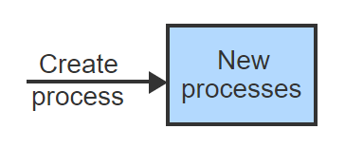
Scheduling Visualized - 1
Processes are created at unpredictable times and enter the system with the process state: new.

Slide 7
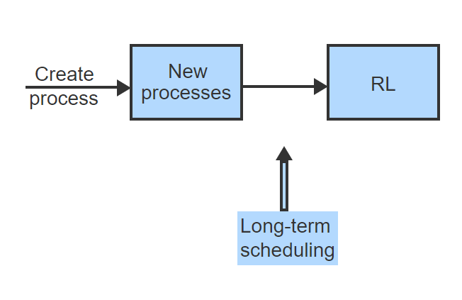
Scheduling Visualized - 2
Long-term scheduling decides which processes are moved to the ready list to compete for the CPU.

Slide 8
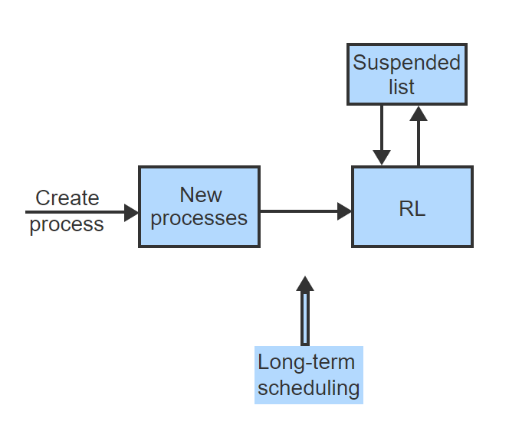
Scheduling Visualized - 3
Processes are also subject to long-term scheduling when suspended and later reactivated by the OS.

Slide 9
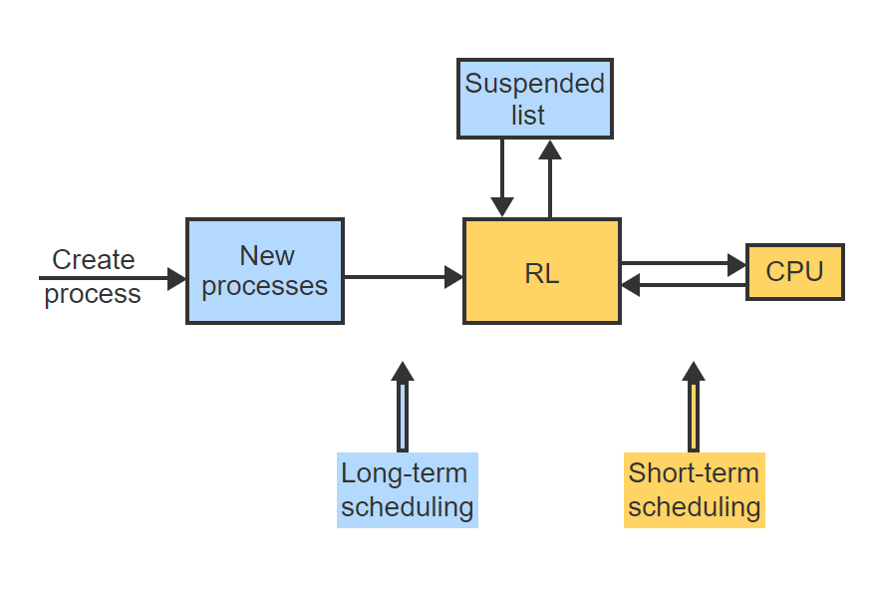
Scheduling Visualized - 4
Short-term scheduling moves processes between the ready list and the CPU.

Slide 10
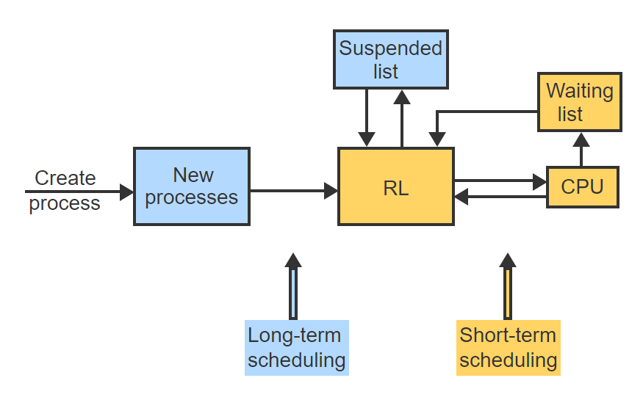
Scheduling Visualized - 5
When a running process becomes blocked and later reenters the RL, short-term scheduling is again applied to let the process compete for the CPU.

Slide 11
Types of Schedulers
Non-Preemptive: A non-preemptive scheduling algorithm allows a running process to continue until the process terminates or blocks on a resource.
Preemptive: A preemptive scheduling algorithm may stop the currently running process and choose another process to run.

Slide 12
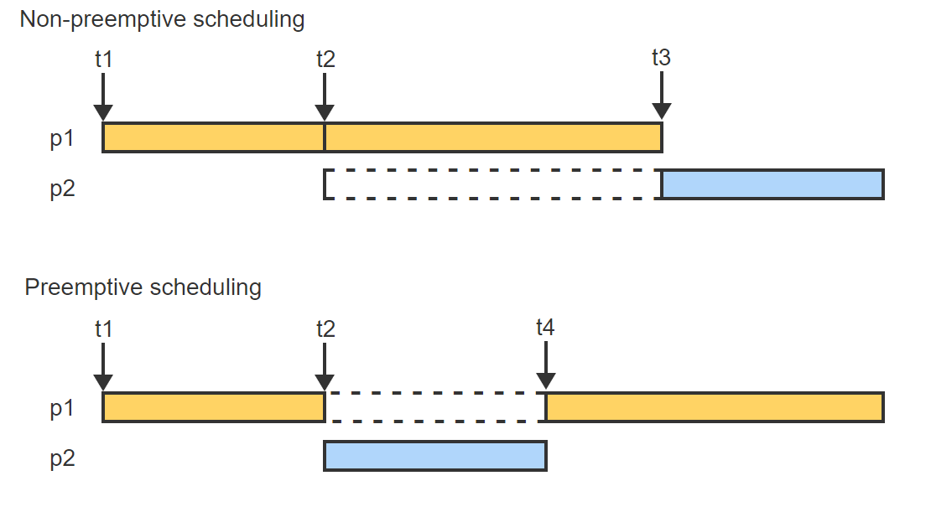
Preemption Visualized

Slide 13
Priority & Arbitration
Process Priority: The priority of a process (or thread) is a numerical value that indicates the importance of the process relative to other processes.
Arbitration Rule: The arbitration rule decides which process should proceed if two or more processes have the same priority.

Slide 14
Priority Considerations (Short Term)
Parameter | Explanation
Arrival | The point in time when the process enters the RL.
Departure | The point in time when the process leaves the RL by entering the blocked or suspended state, or by terminating all work.
Attained CPU time | The amount of CPU time used by the process since arrival.
Real time in system | The amount of actual time the process has spent in the system since arrival.
Total CPU time | The amount of CPU time the process will consume between arrival and departure. For short-term scheduling, total CPU time is sometimes called the CPU burst.
External priority | A numeric priority value assigned to the process explicitly at the time of creation.
Deadline | A point in time by which the work of the process must be completed.
Period | A time interval during which a periodically repeating computation must be completed. The end of each period is the implicit deadline for the current computation.
Other considerations | The resource requirements of a process, such as the amount of memory used, or the current load on the system.

Slide 15
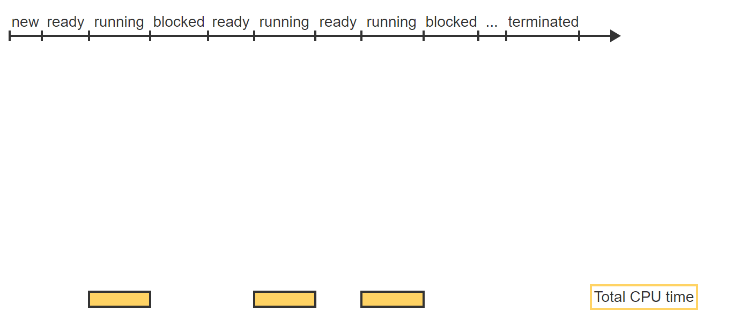
Priority Visualized - 1
A process goes through a series of state transitions starting from new and ending in terminated.

Slide 16
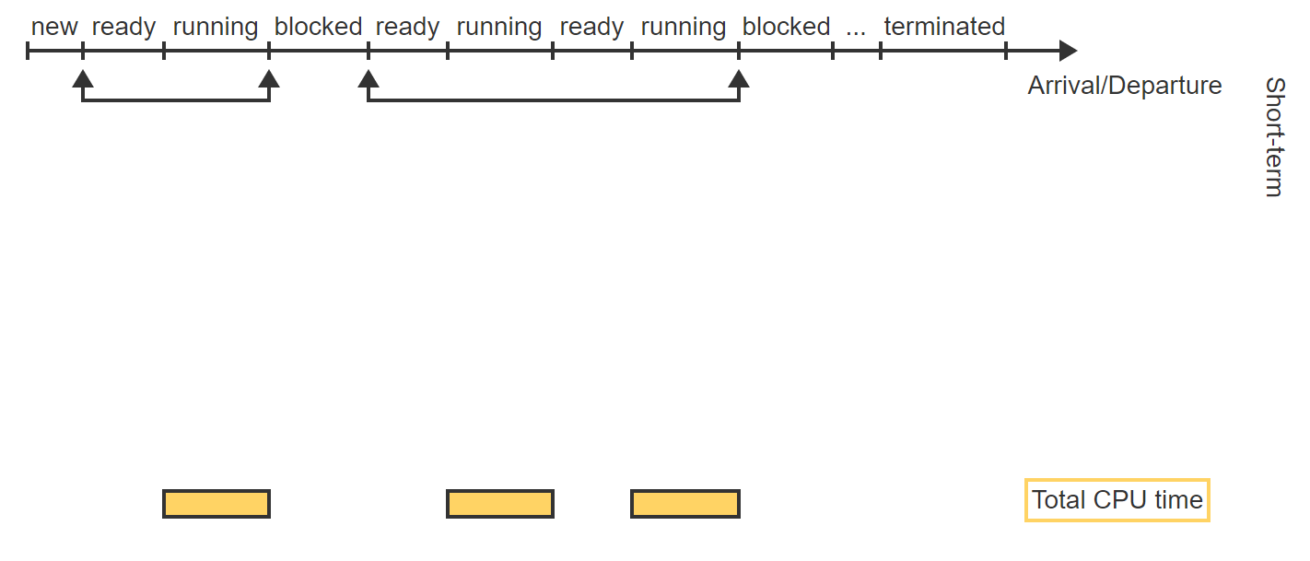
Priority Visualized – 2
For short-term scheduling, each arrival is a transition into ready state (entering RL) and each departure is a transition into blocked state (leaving RL).

Slide 17
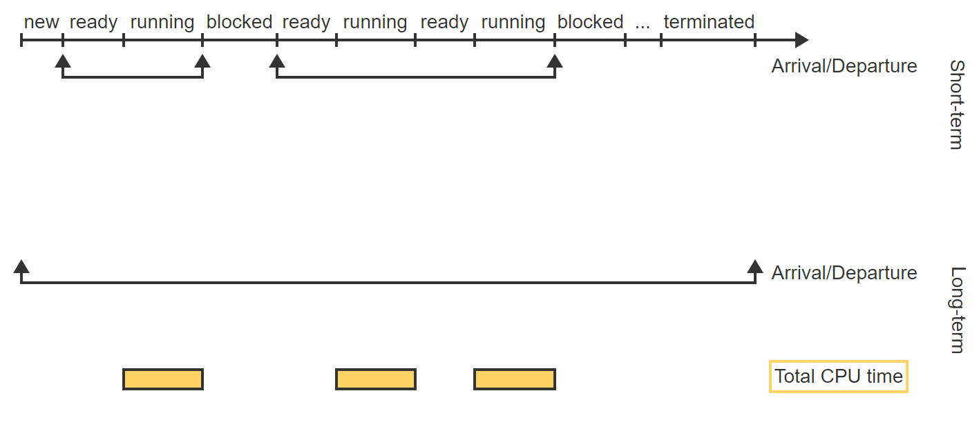
Priority Visualized – 3
For long-term scheduling, arrival is the creation of the process (entering new) and departure is the destruction of the process (leaving terminated).

Slide 18
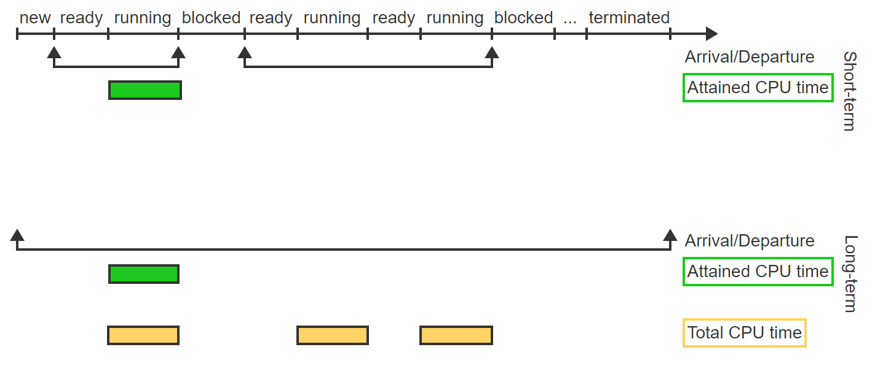
Priority Visualized – 4
The attained CPU time accumulates between arrival and departure while the process is running.

Slide 19
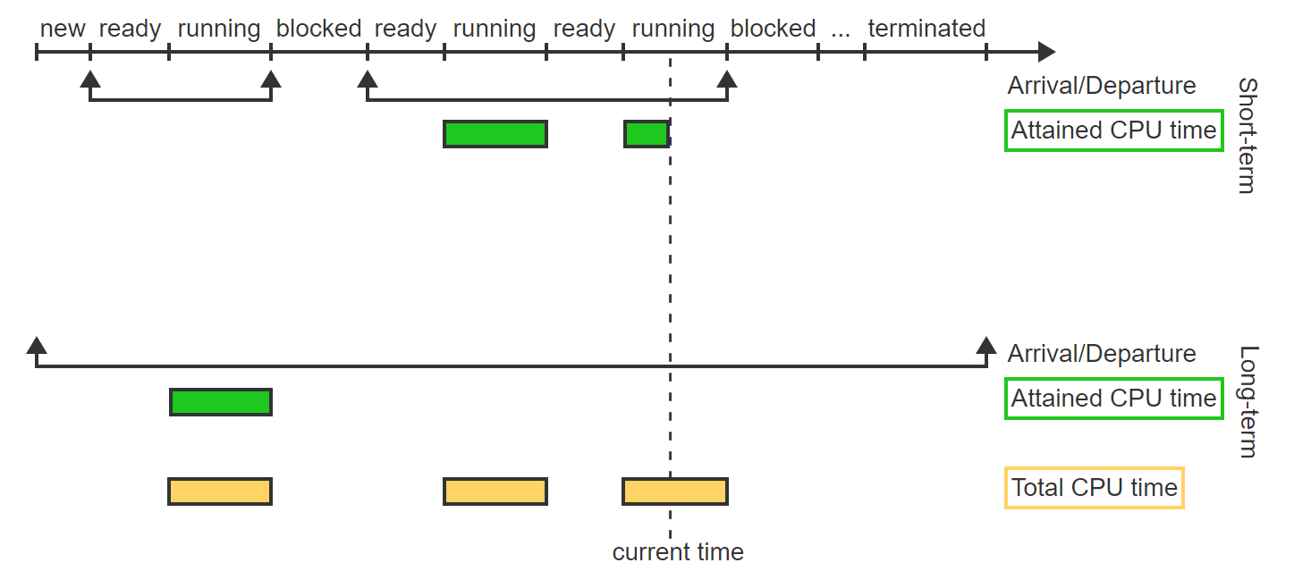
Priority Visualized – 5
For short-term scheduling, the attained CPU time restarts with each arrival and keeps accumulating until the current time.

Slide 20
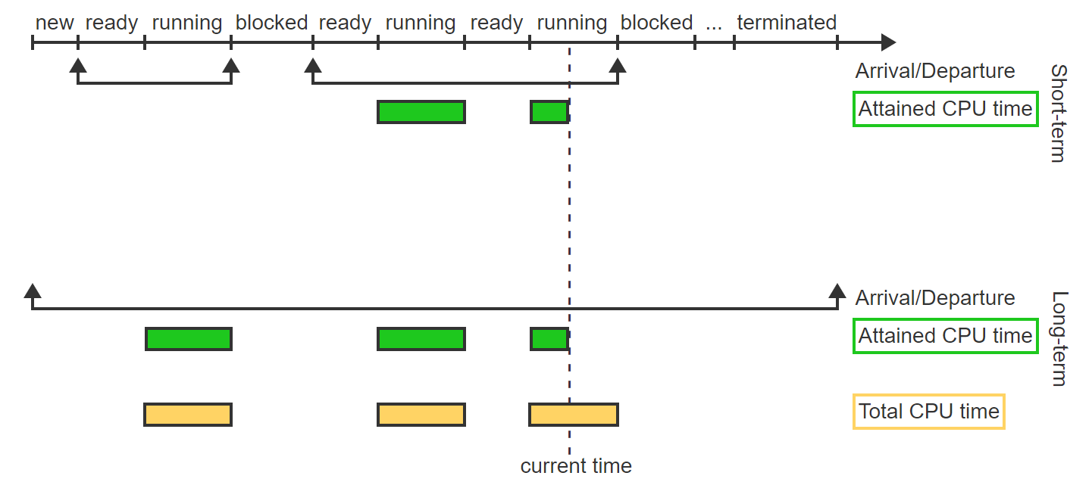
Priority Visualized – 6
For long-term scheduling, the attained CPU time keeps accumulating since the process's creation until the current time.

Slide 21
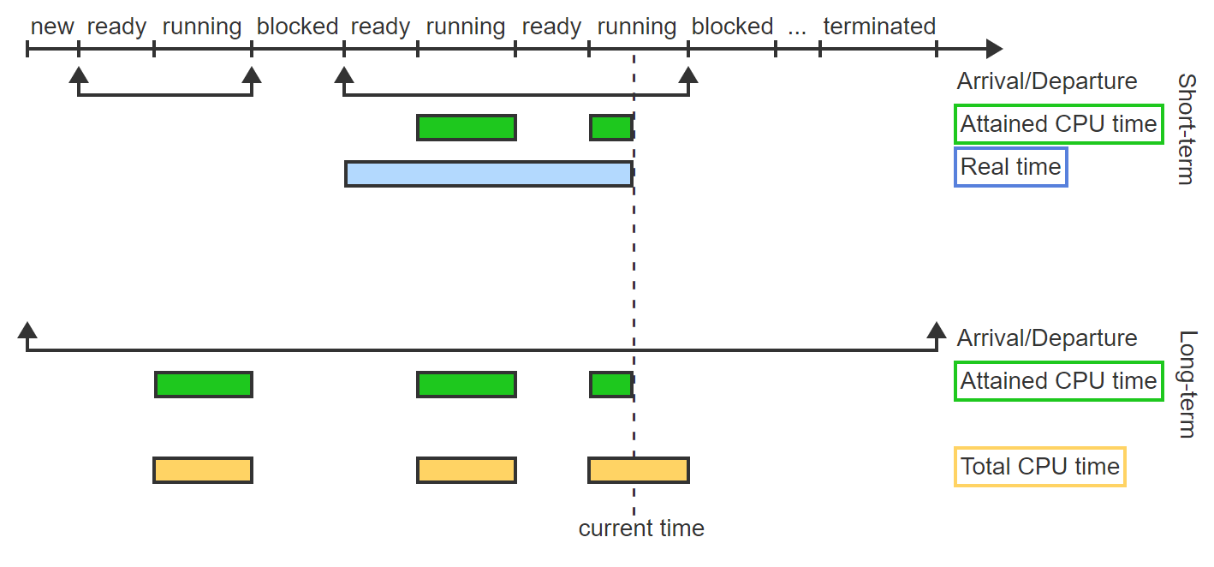
Priority Visualized – 7
The real time for short-term scheduling starts with each arrival and accumulates until the current time regardless of the process's state (running or ready).

Slide 22
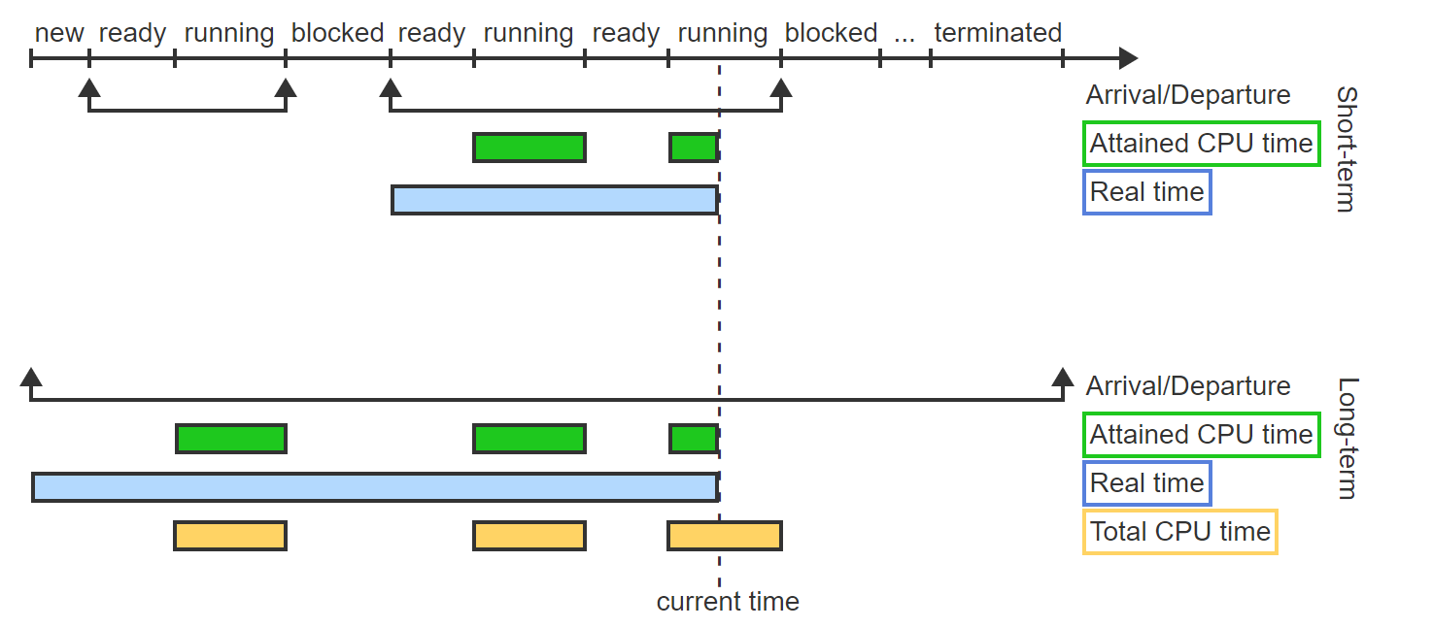
Priority Visualized – 8
The real time for long-term scheduling starts with the process creation and accumulates until the current time regardless of the process's state (running, ready, or blocked).

Slide 23
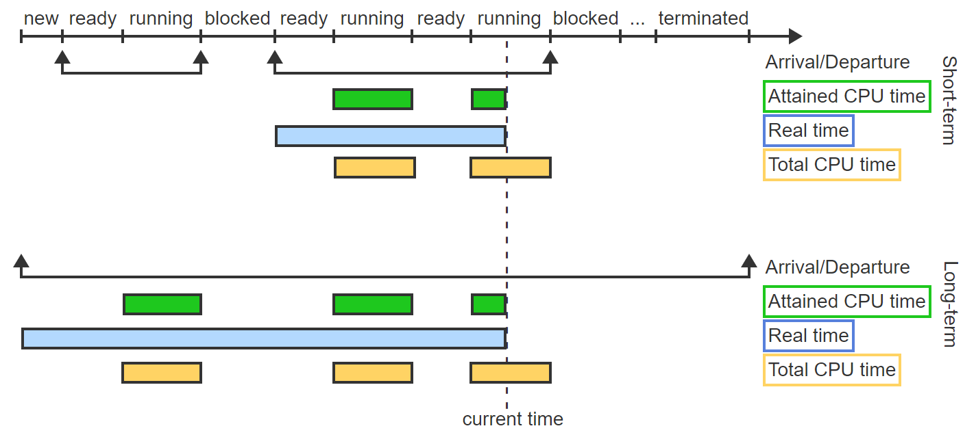
Priority Visualized – 9
The total CPU time is the accumulation of all CPU times (running state) from arrival to departure. For short-term scheduling the accumulation restarts with each new arrival.

Slide 24
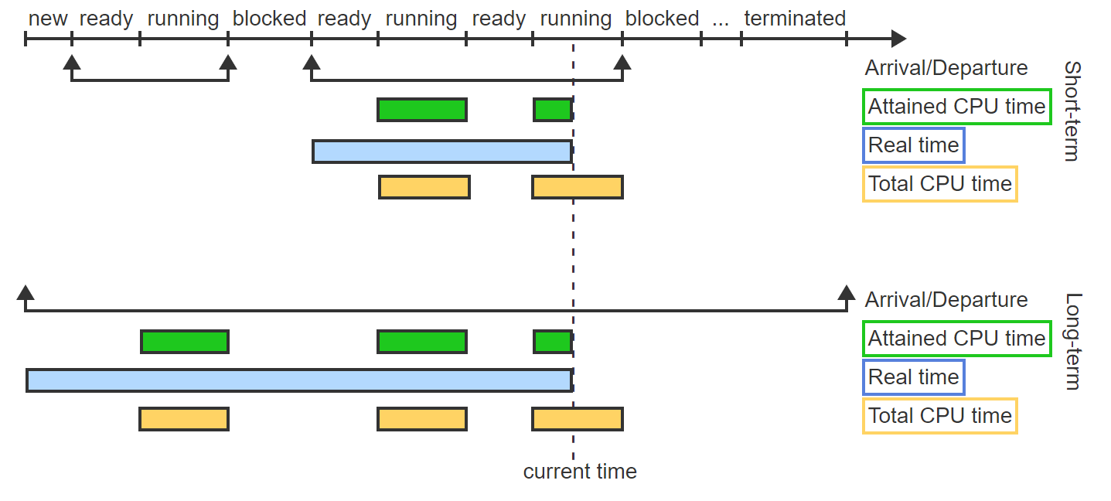
Priority Visualized – 10
Long-term scheduling has only a single arrival. Thus the total CPU time is the accumulation of all CPU times (running states) from process arrival to process termination.

Slide 25
Exercise
A process p starts running at time 0, becomes blocked at time 2, and starts running again at time 5.
p's attained CPU time under short-term scheduling at time 6 will be ______ time units.
p's attained CPU time under long-term scheduling at time 6 will be ______ time units
If p terminates at time 7, the total CPU time under long-term scheduling will be ______ time units.

Slide 26
Exercise – Solutions
A process p starts running at time 0, becomes blocked at time 2, and starts running again at time 5.
p's attained CPU time under short-term scheduling at time 6 will be 1 time unit.
p's attained CPU time under long-term scheduling at time 6 will be 3 time units.
If p terminates at time 7, the total CPU time under long-term scheduling will be 4 time units.

Slide 27
Scheduling Batch Processes
A batch process performs a long-running and generally repetitive task that does not require any intervention from the user. Ex: Payroll, insurance claims processing, weather prediction, scientific calculations.
Note: In the early days of computing, batch processing referred to submitting multiple computations, known as jobs, to be executed as a "batch" without manual intervention. In modern computing, any long-running computation that does not require interaction with a user is called a batch job or batch process.

Slide 28
FIFO (FCFS) Scheduling Algorithm
The FIFO (First-In-First-Out) algorithm, also known as FCFS (First-Come-First-Served), schedules processes strictly according to the process arrival time. The earlier the arrival, the higher the priority.
FIFO is a not preemptive!

Slide 29
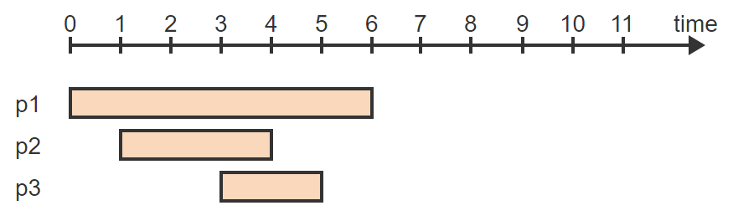
FIFO – Visualized - 1
Three processes need to be scheduled. p1 arrives at t = 0 and will need 6 units of CPU time. p2 arrives at t = 1 and will need 3 units. p3 arrives at t = 3 and will need 2 units.

Slide 30
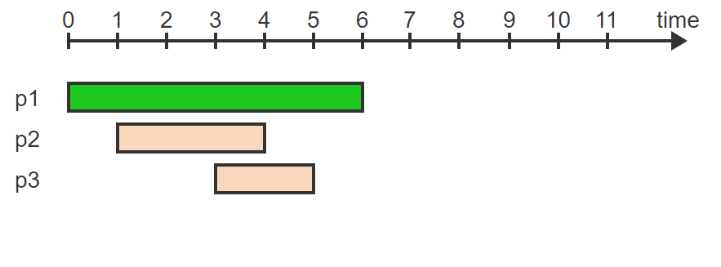
FIFO – Visualized - 2
p1 arrived first and starts immediately at t = 0

Slide 31
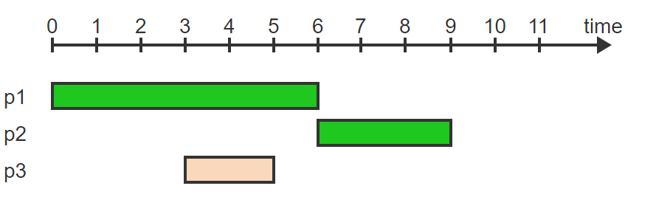
FIFO – Visualized - 3
p2 arrived second and will start as soon as p1 terminates at t = 6

Slide 32
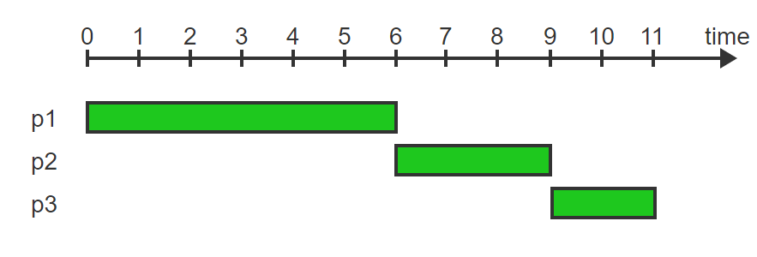
FIFO – Visualized - 4
p3 is the last arriving process and will start when p2 terminates at t = 9

Slide 33
SJF Scheduling Algorithm
The SJF (Shortest Job First) algorithm, also known as SJN (Shortest Job Next), schedules processes according to the total CPU time requirements. The shorter the required CPU time, the higher the priority.
SJF is not preemptive!

Slide 34
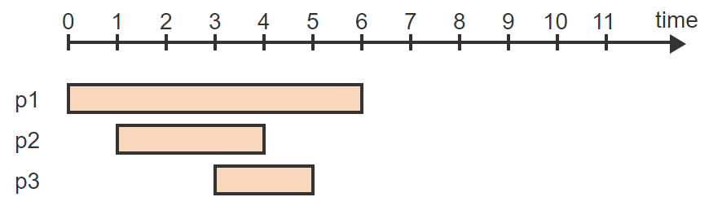
SJF – Visualized – 1
Three processes need to be scheduled. p1 arrives at t = 0 and will need 6 units of CPU time. p2 arrives at t = 1 and will need 3 units. p3 arrives at t = 3 and will need 2 units

Slide 35
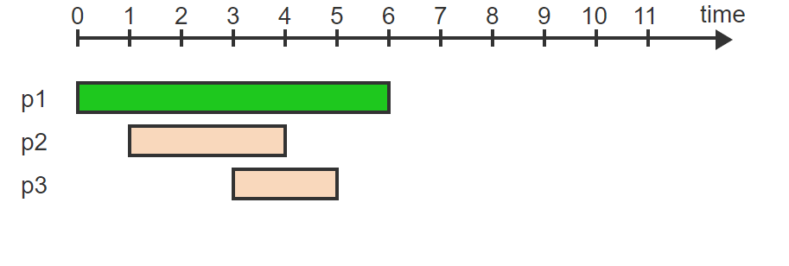
SJF – Visualized – 2
p1 arrived first and starts immediately at t = 0

Slide 36
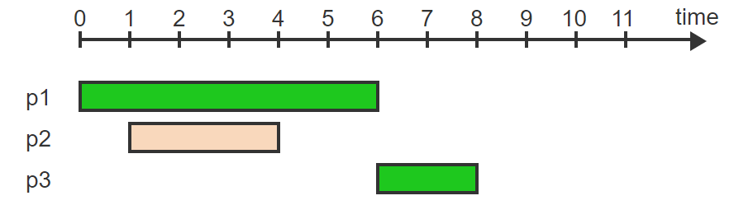
SJF – Visualized – 3
p3 has a shorter total CPU time requirement than p2 and will start as soon as p1 terminates at t = 6

Slide 37
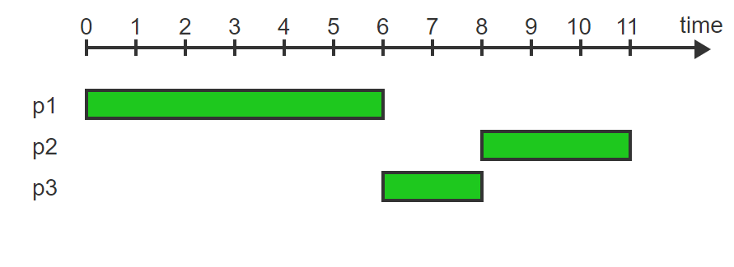
SJF – Visualized – 4
p2 starts when p3 terminates at t = 8

Slide 38
SRT Scheduling Algorithm
The SRT (Shortest Remaining Time) algorithm schedules processes according to the remaining CPU time needed to complete the work. The shorter the remaining CPU time, the higher the priority.
SRT is the preemptive version of SJF.

Slide 39
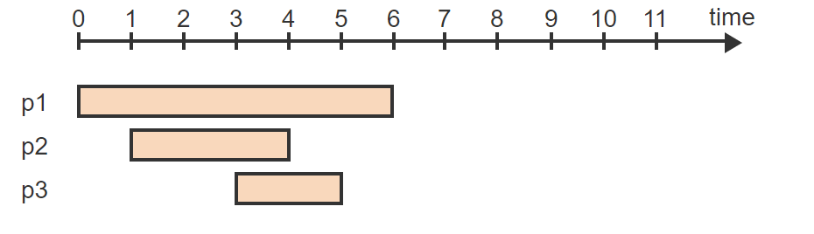
SRT – Visualized – 1
Three processes need to be scheduled. p1 arrives at t = 0 and will need 6 units of CPU time. p2 arrives at t = 1 and will need 3 units. p3 arrives at t = 3 and will need 2 units

Slide 40
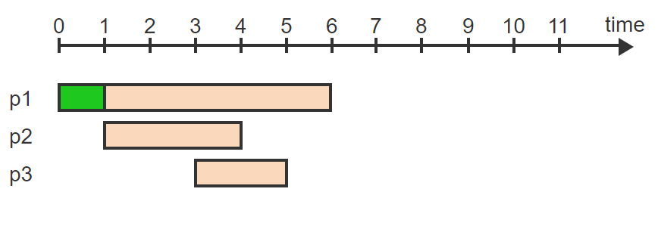
SRT – Visualized – 2
p1 arrives first and starts immediately at t = 0

Slide 41
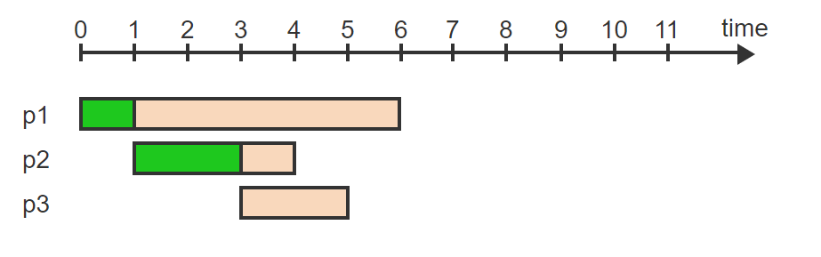
SRT – Visualized – 3
p2 arrives at t = 1. p2's remaining time is 3 units while p1's remaining time is 5 units. Thus p2 preempts p1 and starts at t = 1

Slide 42
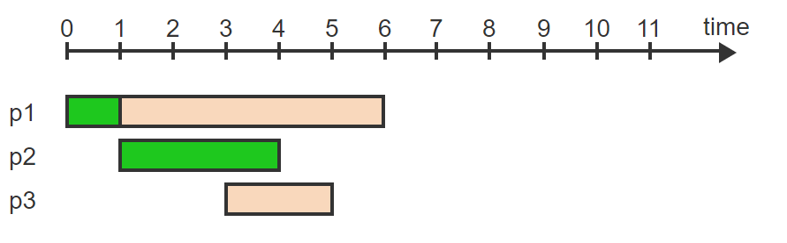
SRT – Visualized – 4
p3 arrives at t = 3. p3's remaining time is 2 units while p2's remaining time is only 1 unit. Thus p2 continues running until t = 4

Slide 43
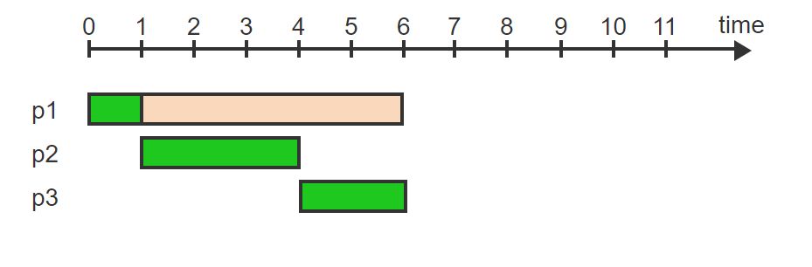
SRT – Visualized – 5
At t = 4, p1's remaining time is 5 units and p3's remaining time is 2 units. Thus p3 starts and runs until t = 6

Slide 44
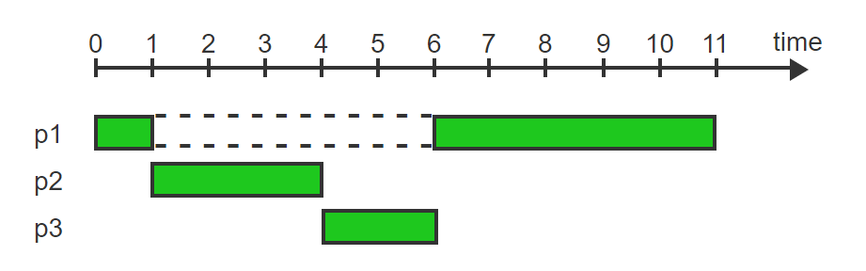
SRT – Visualized – 6
Finally, p1 restarts at t = 6 and terminates at t = 11

Slide 45
Estimating Total CPU Time
For long-term scheduling the total CPU time is measured between the process creation and process destruction. The time can be estimated from previous runs of the same program or may be supplied by the programmer.
For short-term scheduling, the total CPU time (CPU burst) changes for each arrival/departure period. The total CPU time is not known in advance but can be estimated based on past behavior. The most common approach uses exponential averaging, which combines the last estimate of the total CPU time: S_{n}, with the last actually observed total CPU time: T_{n}, to predict the next total CPU time, S_{n+1}:
S_{n+1} = αT_{n} + (1-α)S_{n}
α controls the relative weight of the last observation T_{n} versus the history of past predictions S_{n}

Slide 46
Exercise
Determine the predicted value S_{n+1} for S_{n} = 10, T_{n} = 12 and α = 0.5

Slide 47
Exercise Solution
S_{n+1}= αT_{n} + (1- α)S_{n}
=
0.5 * 12 + 0.5 * 10
=
6 + 5
=
11

Slide 48
Exercise
Now determine the predicted value S_{n+1} for S_{n} = 10, T_{n} = 12 and α = 0.1

Slide 49
Exercise Solution
S_{n+1}= αT_{n} + (1- α)S_{n}
=
0.1 * 12 + 0.9 * 10
=
1.2 + 9
=
10.2

Slide 50
Measuring Performance
The turnaround time of a process is the time between arrival and departure, and is the sum of the total CPU time and the waiting time.
The average turnaround time (ATT) for a set of n processes is the mean of the n individual turnaround times.
Starvation is the indefinite postponement of a process while other processes are allowed to proceed. Both SJF and SRT can lead to starvation.

Slide 51
Scheduling Algorithm Performance
Take a guess, which of the scheduling algorithms we have seen will have the best ATT and why?
The real answer is it depends.

Slide 52
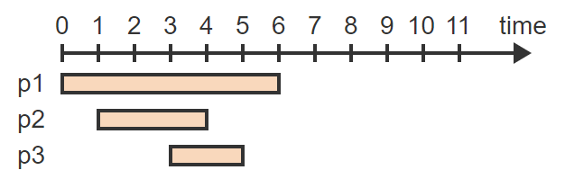
Scheduling Algorithm Performance – Visualized – 1
p1 arrives at time 0 and will need 6 units of CPU time. p2 arrives at time 1 and will need 3 units of CPU time. p3 arrives at time 3 and will need 2 units of CPU time

Slide 53
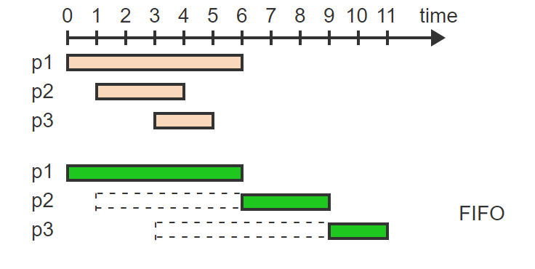
Scheduling Algorithm Performance – Visualized – 2
Under FIFO, all processes start and terminate in the order of arrival

Slide 54
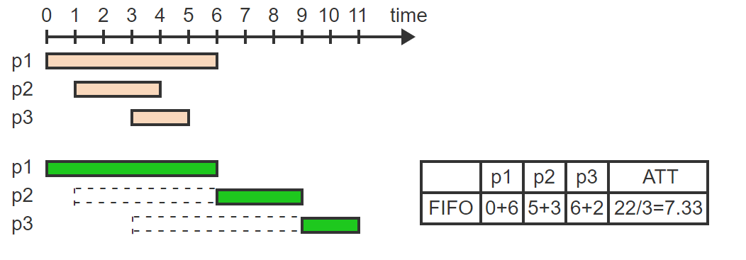
Scheduling Algorithm Performance – Visualized – 3
p1 starts with 0 waiting time and runs for 6 units. p2 waits for 5 units and runs for 3 units. p3 waits for 6 units and runs for 2 units. Average turnaround time = 7.33

Slide 55
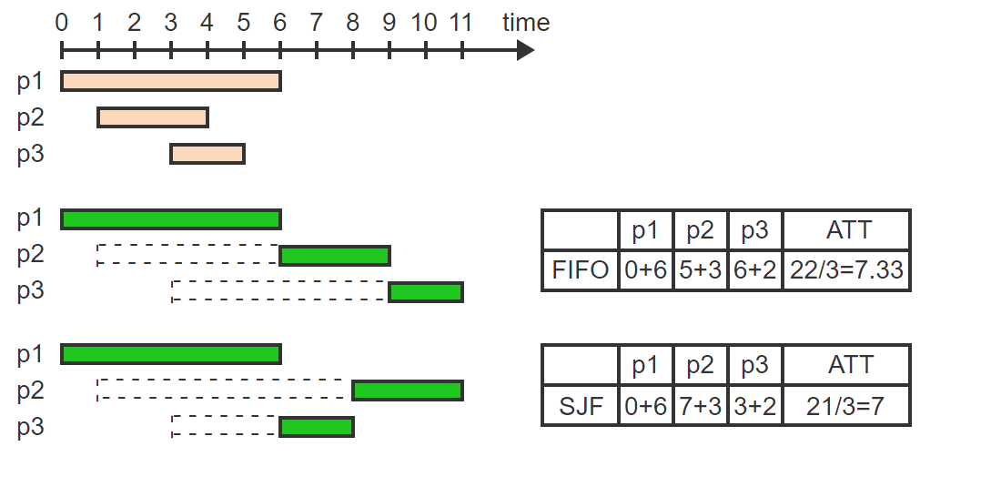
Scheduling Algorithm Performance – Visualized – 4
The turnaround time for p1 is 6 under FIFO. But p3 waits 3 units less while p2 waits only 2 units more. The ATT is reduced to 7

Slide 56
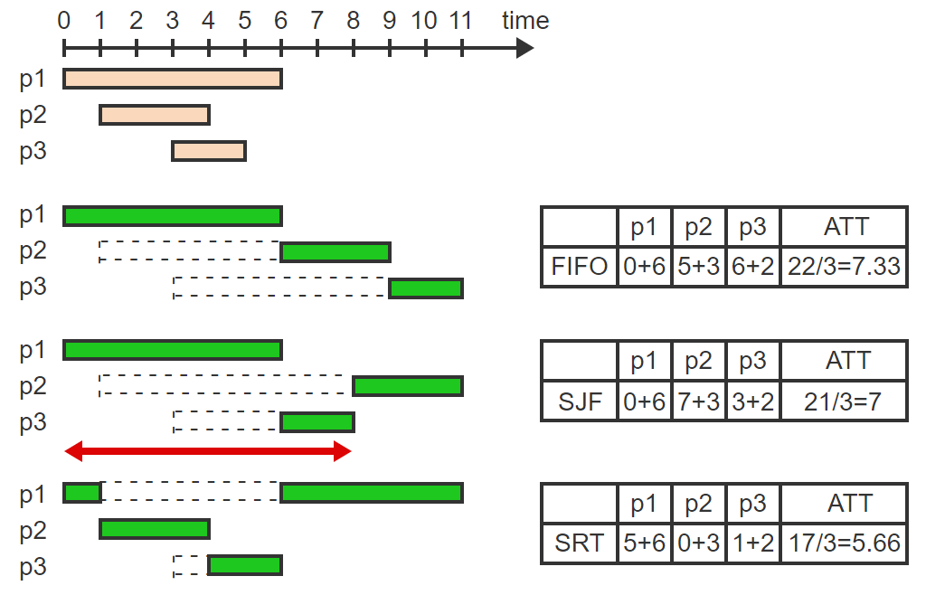
Scheduling Algorithm Performance – Visualized – 4
Compared to SJF, p2's waiting time is reduced by 7 and p3's waiting time is reduced by 2. p1's waiting time is increased by only 5, which reduces the ATT to 5.66

Slide 57
Starvation Issues – SRT
The main issue with SRT is starvation.
In the previous visualization if a new process with a length less than 5 (the remainder of p1) prior to time 6 could lead to an indefinite postponement (starvation) of p1.
Verdict
Most of the scheduling algorithms we have seen are not that great, we can do better!

Slide 58
Interactive Processes Scheduling
An interactive process communicates with the user in the form of a dialog by receiving commands or data from the keyboard or a pointing device and responding by generating output on the user's terminal or another output device.
A time quantum, Q, is a small amount of time (typically 10 to 100 milliseconds) during which a process is allowed to use the CPU.

Slide 59
Round Robin (RR) Scheduling Algorithm
The round-robin (RR) algorithm uses a single queue of processes. The priority is determined solely by a process's position within the queue. The process at the head of the queue has the highest priority and is allowed to run for Q time units. When Q ends, the process is moved to the tail of the queue and the next process now at the head of the queue is allowed to run for Q time units.
Q is typically a pre-determined time quantum.

Slide 60
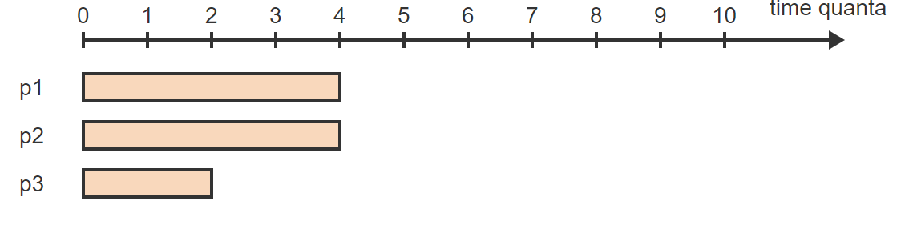
RR – Visualized – 1
Three processes with total CPU times of 4, 4, and 2 start executing under RR

Slide 61
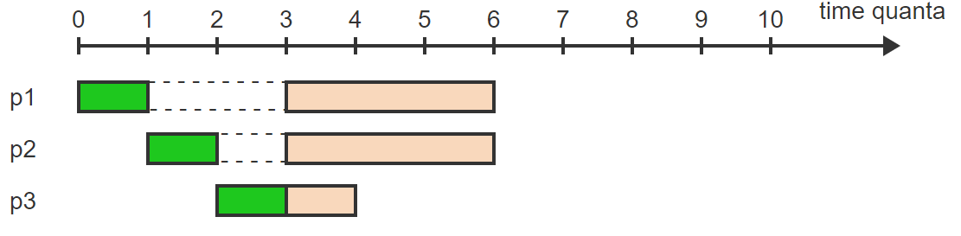
RR – Visualized – 2
p1 executes for 1 quantum, then p2, then p3

Slide 62
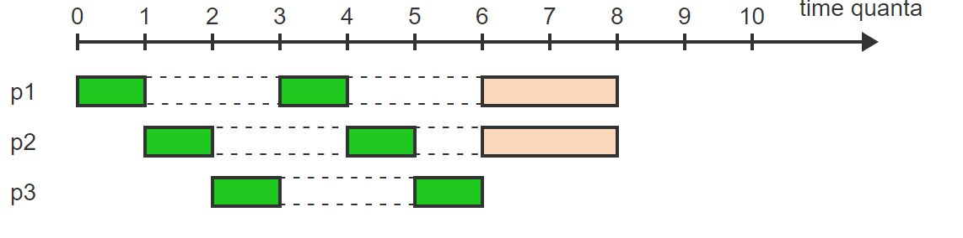
RR – Visualized – 3
The same cycle repeats: p1, p2, p3 execute for 1 quantum each. p3 terminates

Slide 63
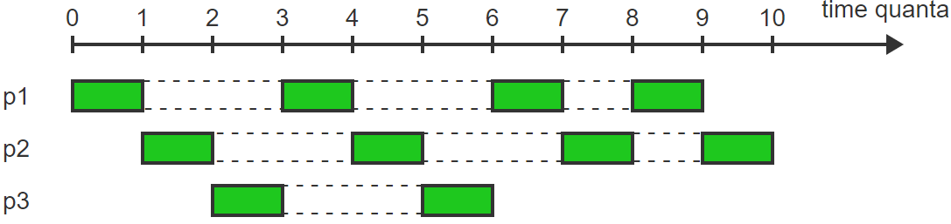
RR – Visualized – 4
p1 and p2 then share the CPU using RR until both terminate

Slide 64
Multilevel (ML) Scheduling Algorithm
Multilevel (ML) scheduling maintains a separate queue of processes at each priority level. Within each level, processes are scheduled using RR.

Slide 65
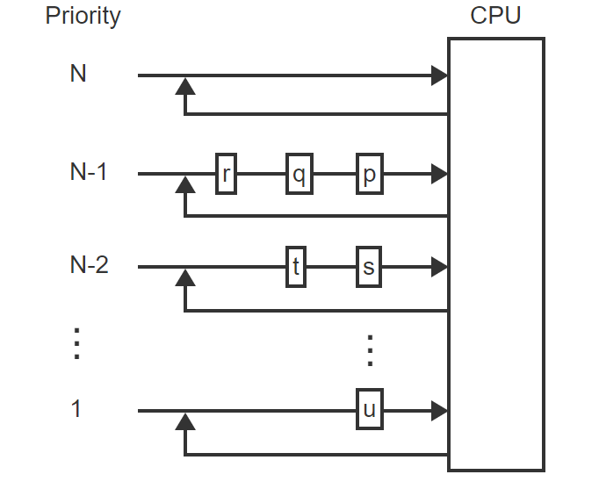
ML – Visualized – 1
ML maintains processes in queues at N different priority levels

Slide 66
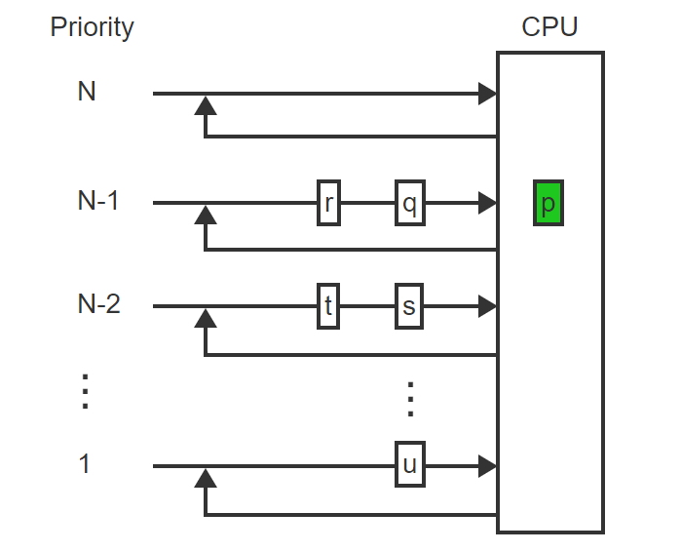
ML – Visualized – 2
The process at the head of the highest-priority queue (p) is selected for execution

Slide 67
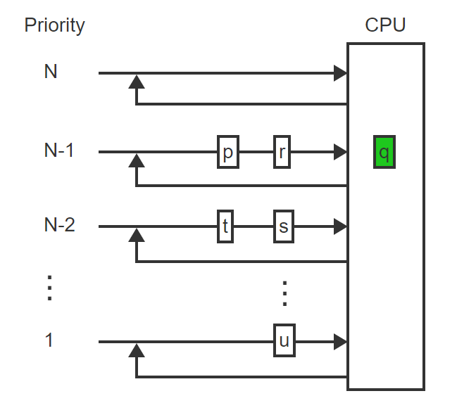
ML – Visualized – 3
When the maximum time allowable for this level expires, the running process (p) moves to the tail of the same queue and the next process (q) starts using the CPU

Slide 68
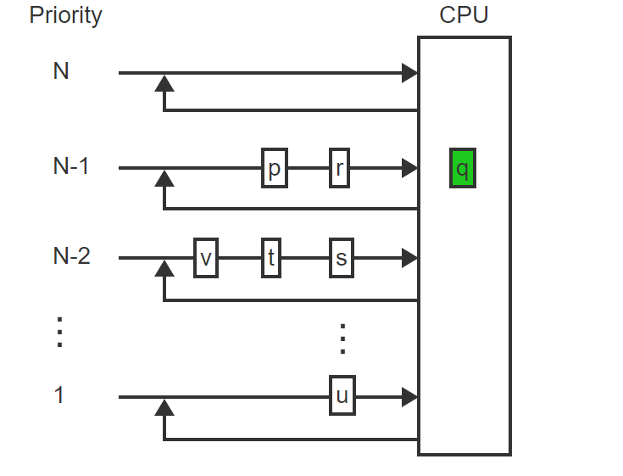
ML – Visualized – 4
A new process (v) with priority N-2 is entered at the tail of the corresponding queue

Slide 69
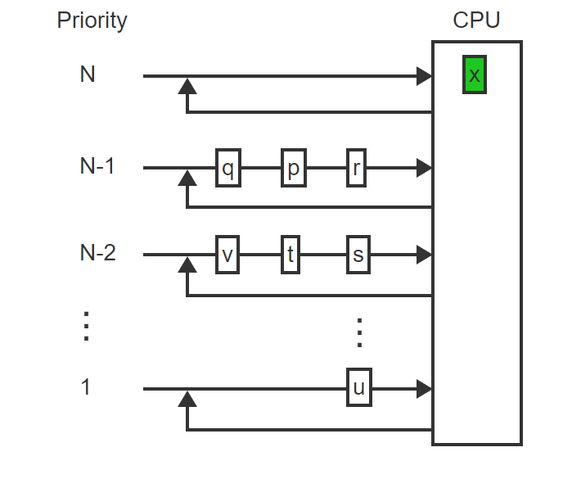
ML – Visualized – 5
A new process (x) with a priority higher than the currently running process (q) preempts the running process

Slide 70
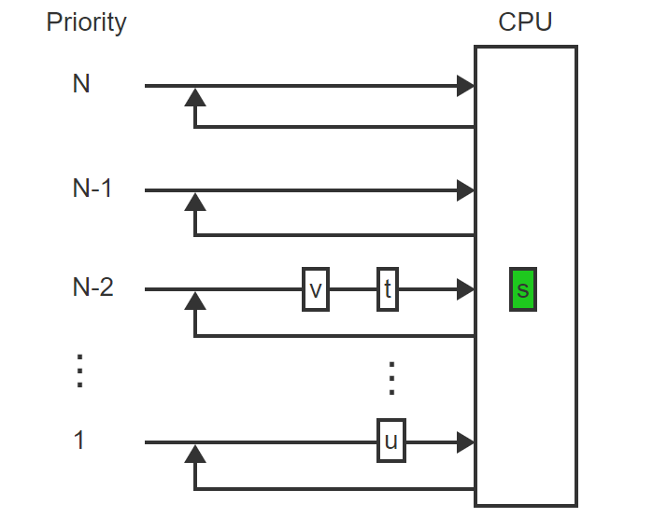
ML – Visualized – 6
Processes at a given level can run only if all queues at higher levels are empty. Ex: s will run only after processes at levels N and N-1 terminate

Slide 71
Multilevel Feedback (MLF) Scheduling Algorithm
Under the multilevel feedback (MLF) algorithm a newly arriving process enters the highest-priority queue, N, and is allowed to run for Q time units. When Q is exceeded, the process is moved to the next lower priority queue, N-1, and is allowed to run for 2Q time units. The quantum size is doubled with each decreasing priority level.

Slide 72
Response Time (Performance Metric)
The response time of a process is the elapsed time from the submission of a request. This is a performance metric.

Slide 73
Verdict
Which of the scheduling algorithms we discussed is the best?
I will leave you to investigate that!
We have more content to cover on the topic of scheduling believe it or not. This is enough for one lecture; we need to move on to C Programming.
We will cover the remaining content next lecture.

Slide 74
Onto C

Slide 75
C Variable Names
Variable Names
Names may contain letters, digits and underscores
The first character must be a letter or an underscore.
Case matters!
C keywords cannot be used as variable names.
present, hello, y2x3, r2d3, ... /* OK *
_1993_tar_return /* OK but don’t */
Hello#there /* illegal */
double /* shouldn’t work */
2fartogo /* illegal */

Slide 76
C Variables Names
Suggestions regarding variable names:
Use variable names that are descriptive
Adopt and stick to a standard naming convention
I choose lower camel case.
Don’t use variable names starting with an underscore.
Often used by the operating system and easy to miss.
Don’t use uppercase only variable names.
Generally, these are pre-processor macros (covered later).

Slide 77
C Basic Types
There are only a few basic data types in C:
Basic Type | Description
char | A single byte, capable of holding one character.
int | An integer of fixed length, typically reflecting the natural size of integers on the host machine (i.e., 32 or 64 bits)
float | single-precision floating point
double | double precision floating point

Slide 78
C Basic Types
There are several qualifiers which can be applied to the basic types to alter then length.
Length of Data Qualifiers:
short int
“shorter” int, <= number of bits in an int
You can also just write “short”
long int
a "longer int", >= number of bits in an int
a "longer int", >= number of bits in an int
can also just write "long“
long double
generally extended precision floating point

Slide 79
C Basic Types
There are also several qualifiers which can be applied to the basic types to sign or unsign a basic type.
Signed & Unsigned Data Qualifiers:
unsigned int
An int type with no sign
If int has 32-bits, range from 0..2^32-1
This also works with long and short
unsigned char
A number from 0 to 255
signed char
A number from –128 to 127 (8-bit signed value)
Highly similar to byte in Java

Slide 80
C Basic Types
All types have a fixed size associated with them.
This size can be determined at compile time.
Example storage requirements:
These numbers are highly variable between C compilers and computer architectures.
Programs that rely on these figures must be very careful to make their code portable (ie. Try not to avoid relying on the size of the predefined types)
Data | Bytes Required
The letter x (char) | 1
The number 100 (int) | 4
The number 120.145 (double) | 8

Slide 81
Formatted Printing with printf
The printf function is used to output information (both data from variables and text) to standard output.
A C library function in the library.
Takes a format string and parameters for output.
printf(format string, arg1, arg2, …);
e.g., printf("The result is %d and %d\n", a, b);
The format string contains:
Literal text: is printed as is without variation
Escaped sequences: special characters preceded by \
Conversion specifiers: % followed by a single character
Indicates (usually) that a variable is to be printed at this location in the output stream.
The variables to be printed must appear in the parameters to printf following the format string, in the order that they appear in the format string.

Slide 82
Formatted Printing with printf
Conversion Specifiers
There must be one conversion specifier for each argument being printed out.
Ensure you use the correct specifier for the type of data you are printing.
Specifier | Meaning
%c | Single character
%d | Signed decimal integer
%x | Hexadecimal number
%f | Decimal floating point number
%e | Floating point in “scientific notation”
%s | Character string (more on this later)
%u | Unsigned decimal integer
%% | Just print a % sign
%ld, %lld | long, and long long

Slide 83
Formatted Printing with printf
Escape Sequences:
Sequence | Meaning
\a | Bell (alert)
\b | Backspace
\n | Newline
\t | Horizontal tab
\\ | Backslash
\' | Single quote
\" | Double quotation
\xhh | ASCII char specified by hex digits hh
\ooo | ASCII char specified by octal digits ooo

Slide 84

Formatted Printing with printf
An example use of printf
What do you think the output will be?
#include <stdio.h>
int main() {
int ten=10,x=42;
char ch1='o', ch2='f’;
printf("%d%% %c%c %d is %f\n",
ten,ch1,ch2,x, 1.0*x / ten ); return 0;
}

Slide 85
Reading Numeric Data with scanf
The scanf function is the input equivalent of printf
A C library function in the library
Takes a format string and parameters, much like printf
The format string specifiers are nearly the same as those used in printf
Examples:
scanf ("%d", &x); /* reads a decimal integer */
scanf ("%f", &rate); /* reads a floating point value */
The ampersand (&) is used to get the “address” of the variable
All the C function parameters are “passed by value”
If we used scanf("%d",x) instead, the value of x is passed.
As a result, scanf will not know where to put the number it reads.

Slide 86
Reading Numeric Data with scanf
Reading more than one variable at a time:
For example:
int n1, n2; float f;
scanf("%d%d%f",&n1,&n2,&f);
Use white spaces to separate numbers when input.
5 10 20.3
In the format string:
You can use other characters to separate the numbers:
scanf("value=%d,ratio=%f", &value,&ratio);
You must provide input like:
value=27,ratio=0.8
scanf returns an int
If end-of-file was reached, it returns EOF, a constant defined in
Otherwise, it returns the number of input values correctly read from standard input.

Slide 87
Reading Numeric Data with scanf
One tricky point:
If you are reading into a long or a double, you must precede the conversion specifier with an l (a lower case L)
int main() {
int x;
long y;
float a;
double b;
scanf("%d %ld %f %lf", &x, &y, &a, &b);
return 0;
}

Slide 88
Type Conversion
C allows for conversions between the basic types, implicitly or explicitly.
Explicit conversion uses the cast operator
Example 1
int x=10;
float y,z=3.14;
y=(float) x; /* y=10.0 */
x=(int) z; /* x=3 */
x=(int) (-z); /* x=-3 -- rounded approaching zero */

Slide 89
Type Conversion
Explicit conversion uses the cast operator
Example 2
int i;
short int j=1000;
i=j*j; /* wrong!!! */
i=(int)j * (int)j; /* correct */

Slide 90
Implicit Conversion
If the compiler expects one type at a position, but another type is provided, then implicit conversion occurs.
Conversion during assignments:
char c='a’;
int i;
i=c; /* i is assigned the ASCII code of ‘a’ */

Slide 91
Implicit Conversion
Arithmetic conversion – if two operands of a binary operator are not the same type, implicit conversion occurs:
int i=5 , j=1;
float x=1.0 , y;
y = x / i; /* y = 1.0 / 5.0 */
y = j / i; /* y = 1 / 5 so y = 0 */
y = (float) j / i; /* y = 1.0 / 5 */
/* The cast operator has a higher precedence */

Slide 92
Example
The sizeof() function returns the number of bytes in a data type.
int main()
{
printf("Size of char ......... = %2d byte(s)\n", sizeof(char));
printf("Size of short ........ = %2d byte(s)\n", sizeof(short));
printf("Size of int ........... = %2d byte(s)\n", sizeof(int));
printf(“Size of long long …… = %2d byte(s)\n”, sizeof(long long));
printf("Size of long ......... = %2d byte(s)\n", sizeof(long));
printf("Size of unsigned char. = %2d byte(s)\n", sizeof (unsigned char)); printf("Size of unsigned int.. = %2d byte(s)\n", sizeof (unsigned int)); printf("Size of unsigned short = %2d byte(s)\n", sizeof (unsigned short)); printf("Size of unsigned long. = %2d byte(s)\n", sizeof (unsigned long)); printf("Size of float ........ = %2d byte(s)\n", sizeof(float));
printf("Size of double ....... = %2d byte(s)\n", sizeof(double));
printf("Size of long double .. = %2d byte(s)\n", sizeof(long double));
return 0;
}

Slide 93
Example
Results of a previous run of this code
What will this depend on?
Size of char = 1 byte(s)
Size of short = 2 byte(s)
Size of int = 4 byte(s)
Size of long = 4 byte(s)
Size of long long = 8 byte(s)
Size of unsigned char = 1 byte(s)
Size of unsigned int = 4 byte(s)
Size of unsigned short = 2 byte(s)
Size of unsigned long = 4 byte(s)
Size of float = 4 byte(s)
Size of double = 8 byte(s)
Size of long double =16 byte(s)

Slide 94
Creating Simple Types
typedef creates a new name for an existing type
Allows you to create a new name for a complex old name
Generic syntax
typedef oldtype newtype;
Examples:
typedef long int32; /* suppose we know an int has 32-bits */
typedef unsigned char byte; /* create a byte type */
typedef long double extended;
These are often used with complex data types
Simplifies syntax!

Slide 95
Variable Declaration
Generic Form
typename varname1, varname2, ...;
Examples:
int count;
float a;
double percent, total;
unsigned char x,y,z;
long int aLongInt;
long AnotherLongInt unsigned long a_1, a_2, a_3;
unsigned long int b_1, b_2, b_3;
typedef long int32;
int32 n;
Where declarations appear affects their scope and visibility
Rules are similar to those in Java
Declaration outside of any function are for global variables

Slide 96
Variable Declaration
Initialization
ALWAYS initialize a variable before using it
Failure to do so in C is asking for trouble
The value of an uninitialized variables is undefined in the C standards
Examples:
int count; /* Set aside storage space for count */
count = 0; /* Store 0 in count */
This can be done at definition:
int count = 0;
double percent = 10.0, rate = 0.56;
Warning: be careful about “out of range errors”
unsigned int value = -2500;
The C compiler does not detect this as an error

